Slide 1
SPOTIFY RECOMMENDATION SYSTEM
TSP- AI ML Fundamentals (Capstone Project)
Presented By:
SANJEEV KUMAR V
au422621105311
UNIVERSITY COLLEGE OF ENGINEERING, PANRUTI
Guided By: RAMAR BOSE

Slide 2
OUTLINE
Problem Statement
Proposed System/Solution
Algorithm & Deployment
GitHub Link
Project Demo(photos / videos)
Conclusion
Future Scope
References

Slide 3
Problem Statement
In today's vast music streaming landscape, users often find themselves overwhelmed by the sheer volume of available music, struggling to discover new songs or artists that align with their tastes and preferences. To address this challenge, there is a growing demand for personalized recommendation systems that can intelligently suggest music tailored to individual users' preferences.

Slide 4
Proposed Solution
We propose the development of a personalized music recommendation system leveraging machine learning algorithms and collaborative filtering techniques. This system will analyze users' listening histories, preferences, and behavior patterns to generate accurate and relevant music recommendations. By employing advanced algorithms such as matrix factorization, deep learning, or hybrid models, we aim to deliver personalized music recommendations that enhance user satisfaction and engagement.

Slide 5
Algorithm & Deployment
Data Collection: Gather data on user listening habits, preferences, and song attributes from Spotify SAPI or other sources.Data Preprocessing: Clean and preprocess the data, handling missing values, outliers, and encoding categorical variables.Feature Engineering Extract relevant features from the data, such as user demographics, listening history. genre preferences, and song attributes like tempo, energy, and danceability.Model Selection: Choose appropriate algorithms for recommendation, such as collaborative filtering. content-based filtering of methods Training Train the selected model on historical user interactions and song features data.

Slide 6
GitHub Link
PROJECT HITHUB LINK :
https://github.com/Sanjeevkumar-hub02/Music-recommendation-system-using-Spotify-dataset.git

Slide 7
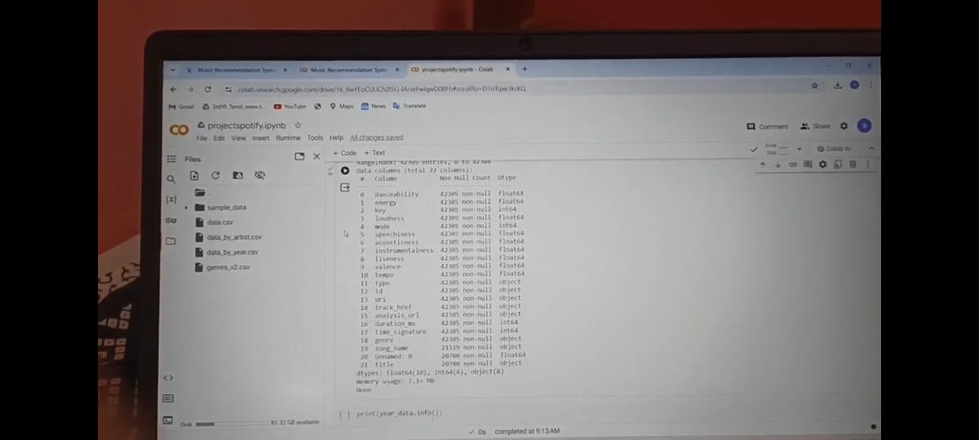
Project Demo(Recorded Video)
https://github.com/Sanjeevkumar-hub02/Music-recommendation-system-using-Spotify-dataset/blob/a8ce40bc95ea032b71e3c0ce8fc4b2ae34df8eb6/Spotify%20recommendation%20demo.mp4

Slide 8
Conclusion
The Spotify Music Recommendation System is a powerful tool that enhances user experience by providing personalized music recommendations tailored to individual preferences. Through advanced algorithms and machine learning techniques, Spotify analyzes user behavior, such as listening history, likes, and dislikes, to curate playlists and suggest songs that align with each user's taste.

Slide 9
Future Scope
The future scope for Spotify s music recommendation system lies in several directions, driven by advancements in technology, data analytics, and user experience. Here are some potential avenues for development:Personalization through Al: Spotify can further enhance its recommendation system by leveraging advanced Al and machine learning techniques. This could involve more sophisticated algorithms that analyze user behavior, preferences, mood, context, and even physiological responses to music, providing highly tailored recommendations.

Slide 10
References
1. Project Github link , Ramar Bose , 2024
2. Project video recorded link (youtube / github), Ramar Bose , 2024
3. Project PPT & Report , Ramar Bose , 2024

Slide 11
THANK YOU

